Slide 1
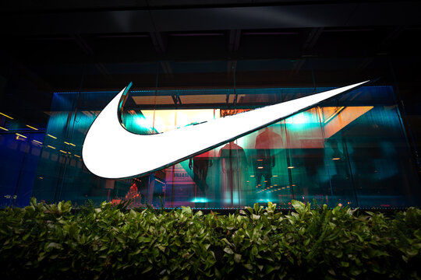


INDEPENDENT STRATEGY CASE STUDY
GEN Z
INDIA
MARKET
EXPANSION
WINNING THE
NEXT GENERATION
Prepared By:
Tushar Verma
CULTURE • COMMUNITY • COMMERCE
INDIA / 2026

Slide 2

THE OPPORTUNITY
OUR STRATEGIC PREMISE
A growth strategy must connect inspiration to action.
01
02
03
RELEVANCE
PARTICIPATION
CONVERSION
Nike can earn a place in the everyday sport and style moments of young Indians.
Community experiences can turn attention into a more active relationship.
Clear discovery and product guidance can help close the intent-to-purchase gap.
NIKE / GEN Z INDIA
STRATEGY CONCEPT / 02

Slide 3


THE CATEGORY
MARKET CONTEXT
₹824bn
SPORT
STYLE
EVERYDAY
India sportswear retail sales, 2025*
11%
Current-value growth, 2025*
₹1.30tn
Forecast category value, 2030*
*Euromonitor public overview. Broad sportswear category—not Gen Z spend, Nike revenue, or a bottom-up TAM.
NIKE / GEN Z INDIA
STRATEGY CONCEPT / 03

Slide 4

MARKET DYNAMICS
THREE FORCES SHAPE THE OPPORTUNITY
NEW MARKET
PENETRATION
DEFINING
CATEGORY
ALL-IN
INVESTMENTS
Youth occasions can expand category relevance beyond core performance needs.
Lifestyle, fitness, and sneaker culture create distinct shopping missions.
Brands compete across product, creators, community, and retail touchpoints.
NIKE / GEN Z INDIA
STRATEGY CONCEPT / 04

Slide 5
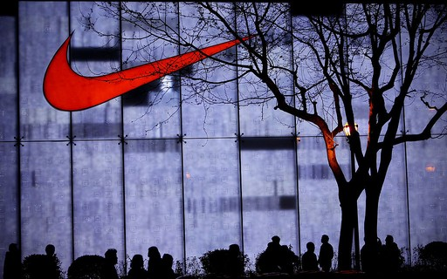
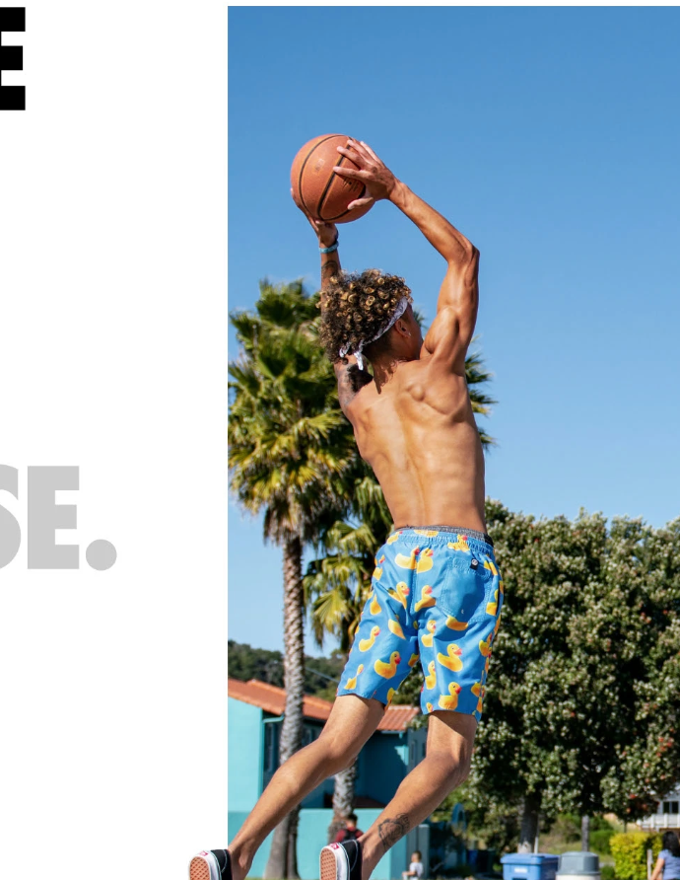
STRATEGIC QUESTION
WE KNOW THE ARENA. THE QUESTION IS HOW WE SHOW UP.
WIN THE
NEXT
GENERATION.
Build stronger relevance with Indian Gen Z through distinctive, measurable market expansion.
01 CULTURE
02 COMMUNITY
03 COMMERCE
Independent hypothetical case study; not affiliated with Nike.
NIKE / GEN Z INDIA
STRATEGY CONCEPT / 05

Slide 6
CONSUMER HYPOTHESES
GEN Z IS NOT ONE CUSTOMER
01
CAMPUS TRENDSETTERS
Identity, peer signals, versatile style
02
FITNESS ENTHUSIASTS
Performance, comfort, progress
03
YOUNG PROFESSIONALS
Everyday utility, quality, ease
04
SNEAKER & CULTURE
Design, drops, cultural credibility
Working segments only; validate through primary research before targeting or scaling.
NIKE / GEN Z INDIA
STRATEGY CONCEPT / 06

Slide 7

MARKET LANDSCAPE
THE COMPETITIVE SET SPANS DIFFERENT JOBS
GLOBAL SPORT
Nike • adidas • Puma
Performance, lifestyle and cultural storytelling
VALUE & ACCESS
Decathlon • Campus
Functional breadth, accessibility and value
COMFORT & SPECIALTY
Skechers • New Balance
Comfort, running and lifestyle niches
WOMEN’S ACTIVE
BlissClub
Women-focused activewear and community
Compare propositions and shopping occasions—not a single league table. Validate with a dated SKU / price / availability audit.
NIKE / GEN Z INDIA
STRATEGY CONCEPT / 07

Slide 8
OPPORTUNITY DIAGNOSIS
THE CONVERSION JOURNEY IS THE STRATEGY
01
02
03
04
05
→
→
→
→
SEE
CARE
EXPLORE
BUY
RETURN
Culture & reach
Relevance & proof
Product discovery
Confidence & ease
Experience & value
HYPOTHESIS
Value may be lost in the hand-offs between inspiration, confidence and purchase. Measure each step.
NIKE / GEN Z INDIA
STRATEGY CONCEPT / 08

Slide 9
STRATEGIC CHOICES
ONE PLATFORM. THREE CONNECTED MOVES.
01 / CULTURE
02 / COMMUNITY
03 / COMMERCE
MAKE SPORT FEEL
LIKE IDENTITY
CREATE REASONS
TO PARTICIPATE
TURN INTENT
INTO CONFIDENCE
Creator-led stories grounded in real youth occasions.
Campus and local movement experiences with follow-through.
Clear product discovery, use-case guidance and purchase paths.
Culture earns attention / Community builds affinity / Commerce captures intent
NIKE / GEN Z INDIA
STRATEGY CONCEPT / 09

Slide 10
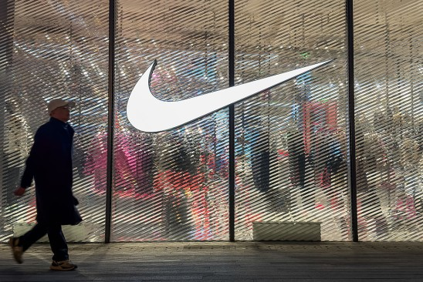
CULTURE
01 / EARN RELEVANCE IN REAL LIFE
PLAY IS A
LIFESTYLE.
Move beyond product-first messaging toward the moments sport already occupies.
CAMPUS SPORT
Participation, teams, peer stories
MOVE YOUR WAY
Fitness, dance, running, everyday motion
STYLE IN MOTION
Versatile looks anchored in activity
NIKE / GEN Z INDIA
STRATEGY CONCEPT / 10

Slide 11

COMMUNITY
02 / TURN AUDIENCES INTO PARTICIPANTS
LOCAL ENERGY
→ BRAND AFFINITY
Connect online discovery with repeatable offline participation.
CAMPUS
Student-led clubs and challenges
CITY
Community runs and meetups
CREATORS
Co-created stories and participation
NIKE / GEN Z INDIA
STRATEGY CONCEPT / 11

Slide 12
COMMERCE
03 / MAKE PRODUCT CHOICE FEEL EASIER
Reduce friction from inspiration to a confident first purchase.
DISCOVER
Relevant edits by activity, style and occasion
1
UNDERSTAND
Simple use-case, fit and product guidance
2
CONFIRM
Transparent availability, delivery and returns
3
RE-ENGAGE
Post-purchase care and relevant next steps
4
TEST / Product-page engagement • Add-to-cart • Conversion • Return rate
NIKE / GEN Z INDIA
STRATEGY CONCEPT / 12

Slide 13
EXECUTION
A 12-MONTH TEST-AND-LEARN ROADMAP
01 - 03
04 - 06
07 - 09
10 - 12
LEARN
PILOT
OPTIMIZE
SCALE
Interviews, directional survey, channel and SKU audit, baseline.
Run focused creator, campus and product-discovery pilots.
Compare cohorts, refine creative and funnel, shift spend to evidence.
Expand repeatable formats; codify operating playbook and measurement.
STAGE GATES / Evidence quality → Unit economics → Repeatability → Scale decision
NIKE / GEN Z INDIA
STRATEGY CONCEPT / 13

Slide 14
KPI FRAMEWORK
MEASURE THE SYSTEM, NOT VANITY METRICS
ATTENTION
INTENT
CONVERSION
VALUE
Reach
Engagement quality
Creator efficiency
Consideration
Qualified product visits
Product detail depth
Add-to-cart
Purchase conversion
CAC / first order
Contribution / order
Repeat purchase
Returns & cancellations
Read results by cohort, city tier, activity, channel and campaign. Establish baselines before launch.
NIKE / GEN Z INDIA
STRATEGY CONCEPT / 14

Slide 15
FINANCIAL CASE
ILLUSTRATIVE ECONOMICS: TEST BEFORE SCALING
Editable scenario assumptions—not Nike internal data or a forecast.
DOWNSIDE
BASE
UPSIDE
₹27.7L
₹2.06Cr
₹5.71Cr
REVENUE
REVENUE
REVENUE
–₹90.6L
–₹30.0L
+₹94.0L
Lower reach / conversion
Working case
Higher reach / conversion
Net contribution after campaign spend; not net profit or causal ROI. Excludes overhead, tax, working capital, cannibalization and full returns effects.
Base-case break-even: approximately 4,525 orders at assumed contribution per order.
NIKE / GEN Z INDIA
STRATEGY CONCEPT / 15

Slide 16
RISKS & GUARDRAILS
WHAT MUST BE TRUE FOR THIS TO WORK?
01
RELEVANCE
Validate youth occasions and creative fit before broad rollout.
02
ECONOMICS
Track contribution after variable costs, not revenue alone.
03
EXECUTION
Pilot with clear owners, partner capacity and operational readiness.
04
MEASUREMENT
Set baselines, holdouts where feasible, and consistent attribution.
05
BRAND
Keep sport credible; avoid chasing short-lived trends without fit.
NIKE / GEN Z INDIA
STRATEGY CONCEPT / 16

Slide 17

VALIDATE
BEFORE
YOU SCALE.
A practical evidence sprint
20 - 30
Consumer interviews across segments and city tiers
≈300
Directional survey to size needs and barriers
DATED AUDIT
Competitor SKU, price and availability audit
GEN Z
INDIA
2026
BASELINE
Funnel and contribution measurement plan
INDEPENDENT HYPOTHETICAL CONSULTING CASE STUDY
Not commissioned by, affiliated with, or endorsed by Nike. Public category data and illustrative assumptions only; hypotheses require validation.

